Slide 1

Ling 438: Statistical learning
Professor Patrick Rebuschat (p.rebuschat@lancaster.ac.uk)

Slide 2
Today
Group presentation
Part I: Three approaches, one phenomenon
Implicit learning
Statistical learning
Second language acquisition
Part II: A single paradigm to investigate implicit (language) learning
Cross-situational learning of everything
Part III: Conclusion and a look ahead

Slide 3
What is statistical learning?

Slide 4
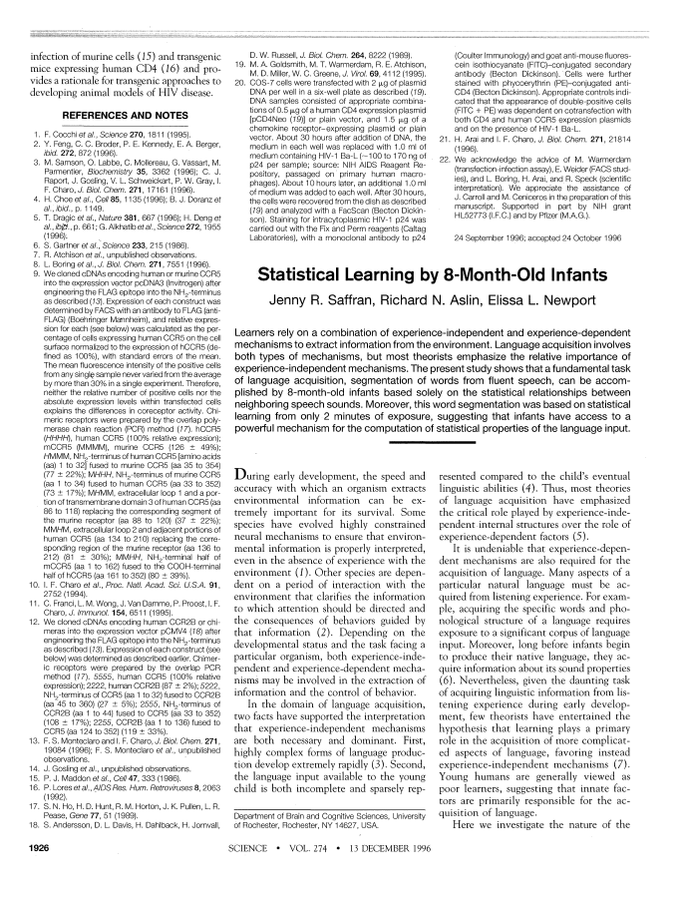
Statistical learning
Our ability to make use of statistical information in the environment to acquire (linguistic) knowledge.

Slide 5
Saffran et al. (1996)
Participants: Eight-month-old infants
Artificial words: pabiku, tibudo, golatu, daropi
Exposure: Two mins of continuous speech stream (pseudowords repeated in random oder)
bidakupadotigolabubidaku…

Slide 6
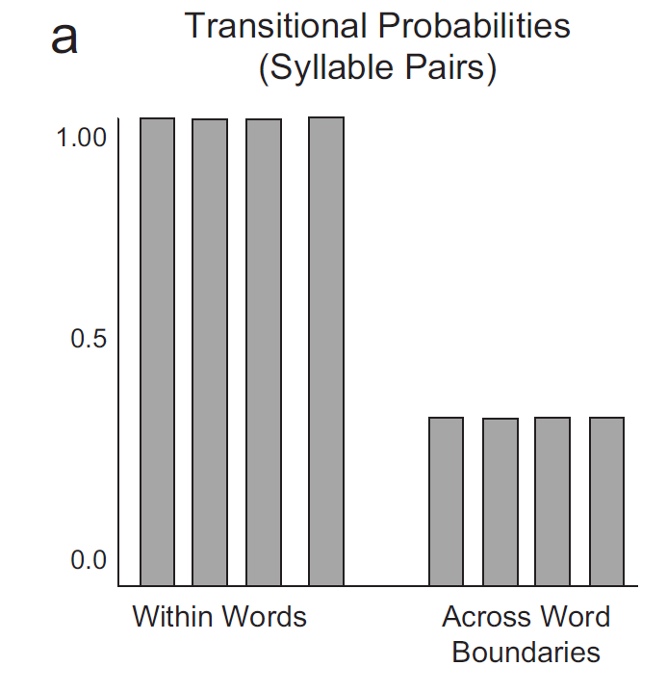
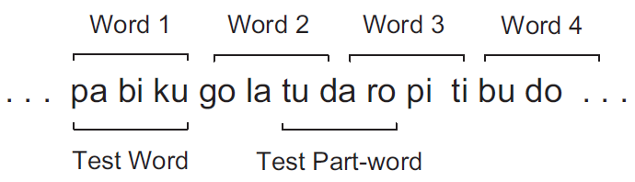
Saffran et al. (1996)

Slide 7
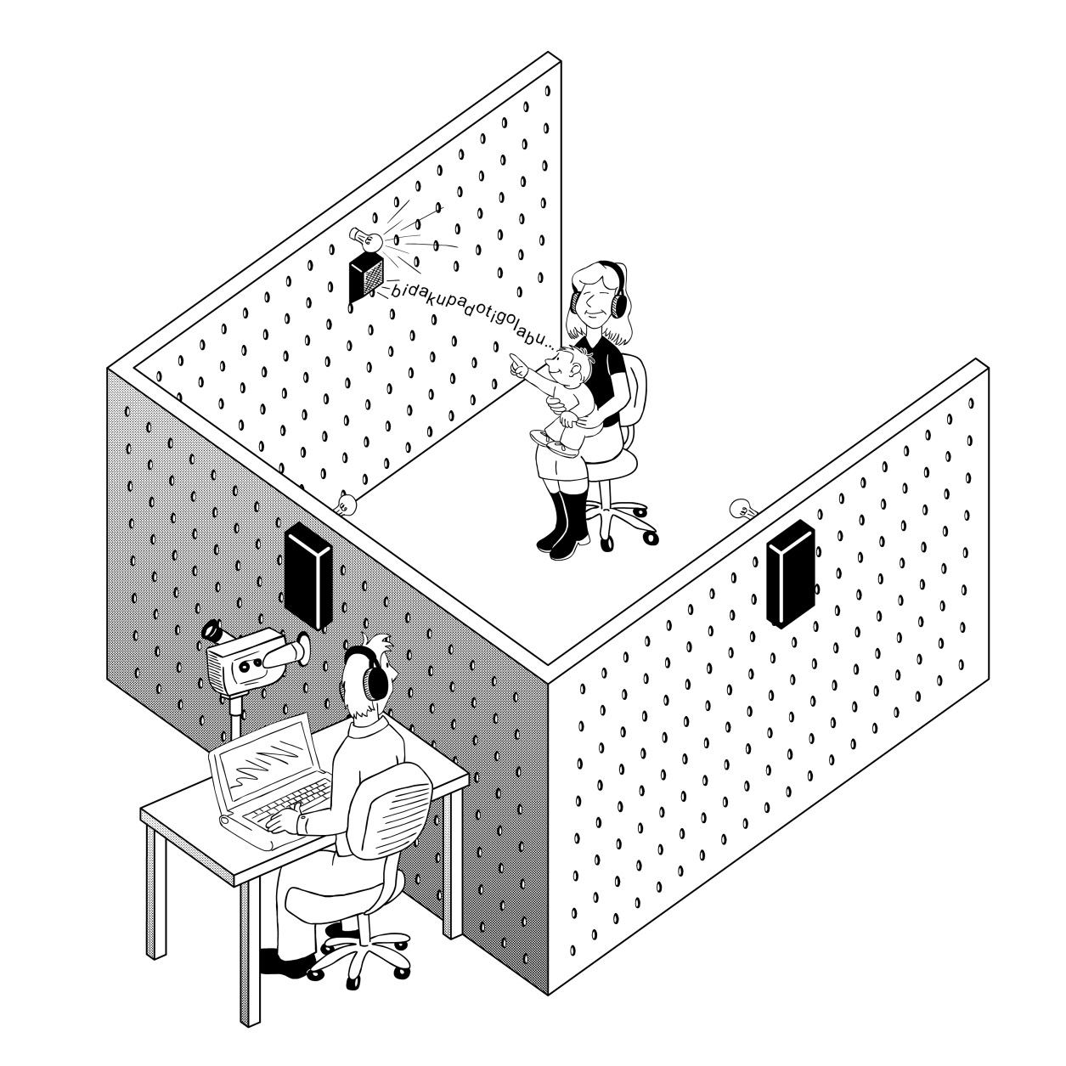
Saffran et al. (1996)
Test: Head-turn preference procedure
Notes:
http://s3images.coroflot.com/user_files/individual_files/original_361431_6Rm2GQV7RtSTqOyyW9cfoUIfw.jpg

Slide 8
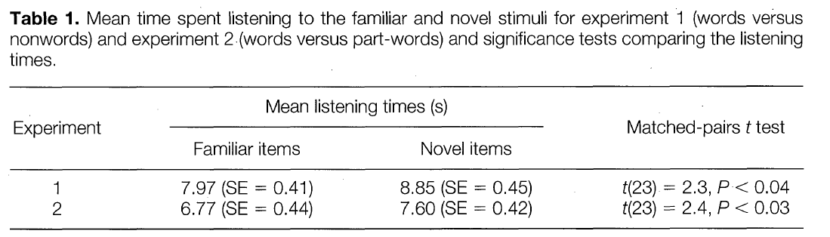
Saffran et al. (1996)
Test:
Infants can distinguish between familiar arrangement of syllables versus novel arrangement of syllables.
Novelty preference

Slide 9
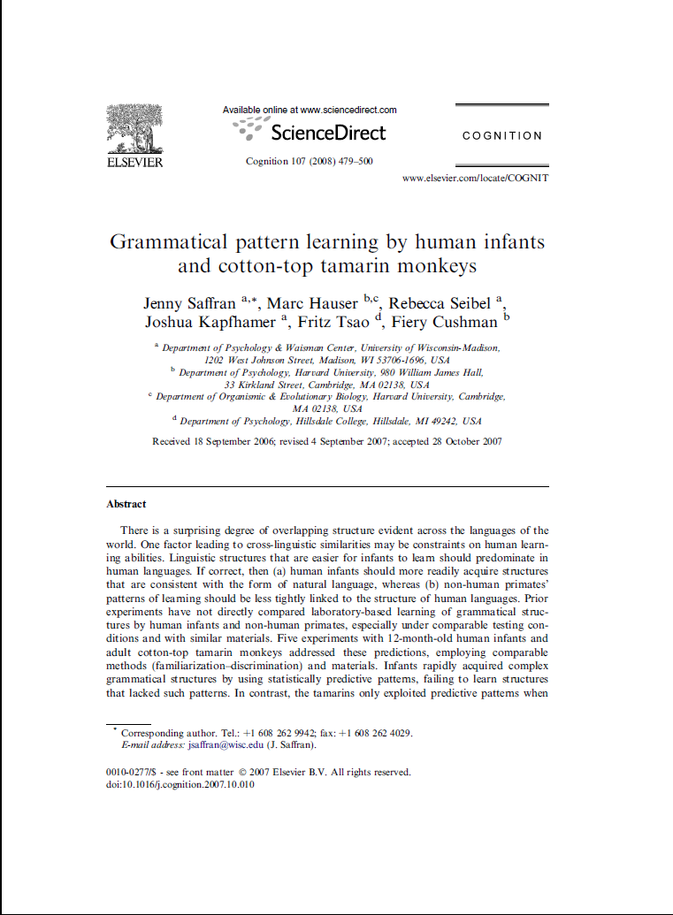
Statistical learning
Since Saffran et al. (1996):
SL well attested in infants, children, and adults.
Can we use SL to succeed in other linguistic tasks?

Slide 10
Statistical learning
Yes, we can… We can use SL to complete a variety of linguistic tasks:
word segmentation and word learning
phonological development
syntactic development
Etc.
What are the units of SL?
Speech sounds, syllables, lexical categories, syntactic phrases, etc.
Notes:
What are the units of SL?
Speech sounds, lexical categories, syntactic phrases, etc.

Slide 11
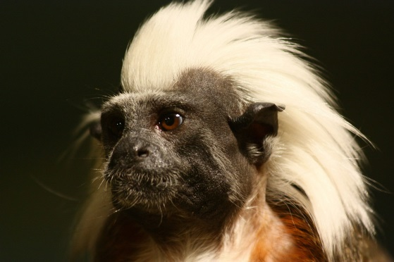
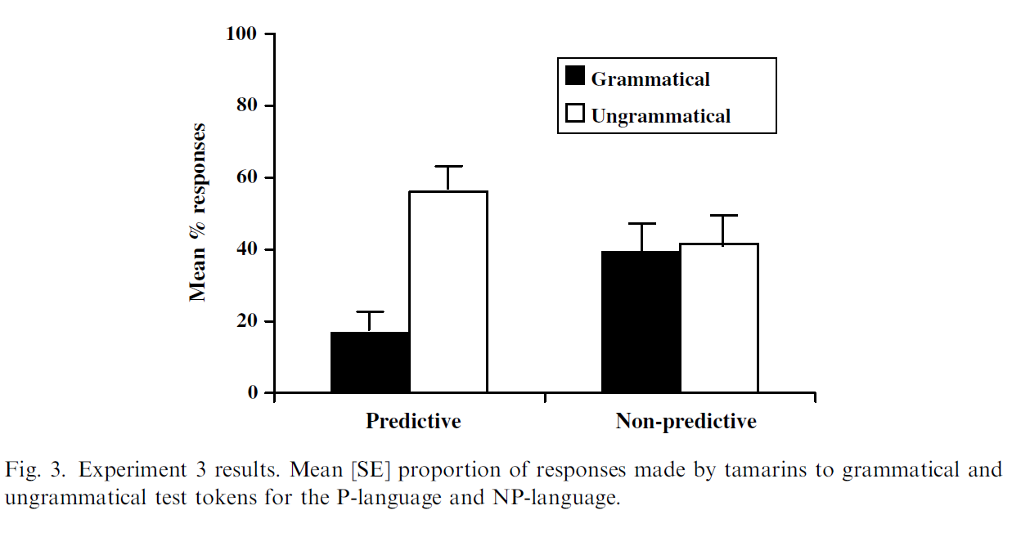
Statistical learning
Basic aspects of SL not unique to human learners (not species-specific).
Saffran et al. (2005, Expt 3)

Slide 12
Statistical learning
What type of statistical information?
Frequency counts
Transitional probabilities
Co-occurrence statistics
Conditional probabilities
Cross-trial statistics

Slide 13


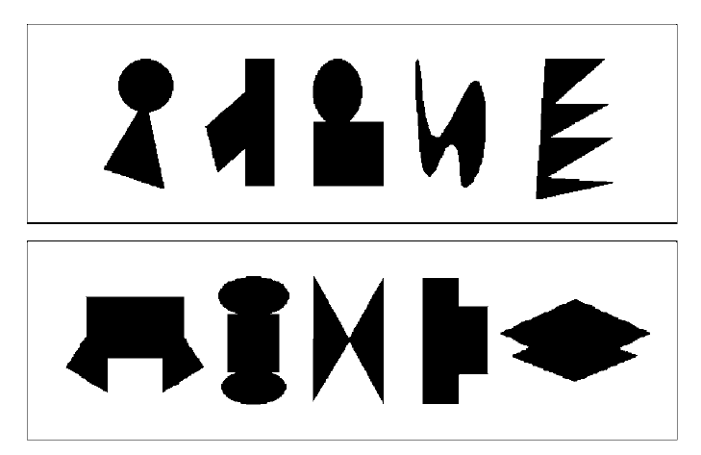






Statistical learning
SL mechanism is domain-general (applies to other modalities and domains).
Conway and Christiansen (2006)
Fiser and Aslin (2002)

Slide 14
Three approaches, one phenomenon?

Slide 15
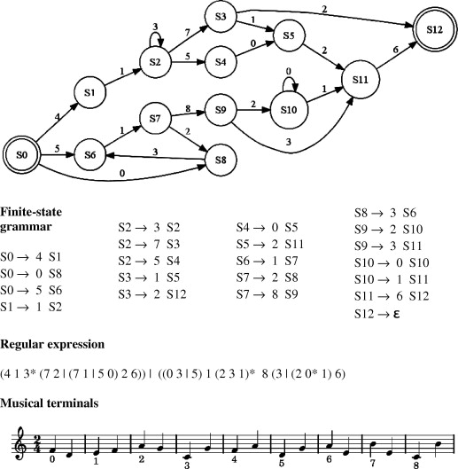
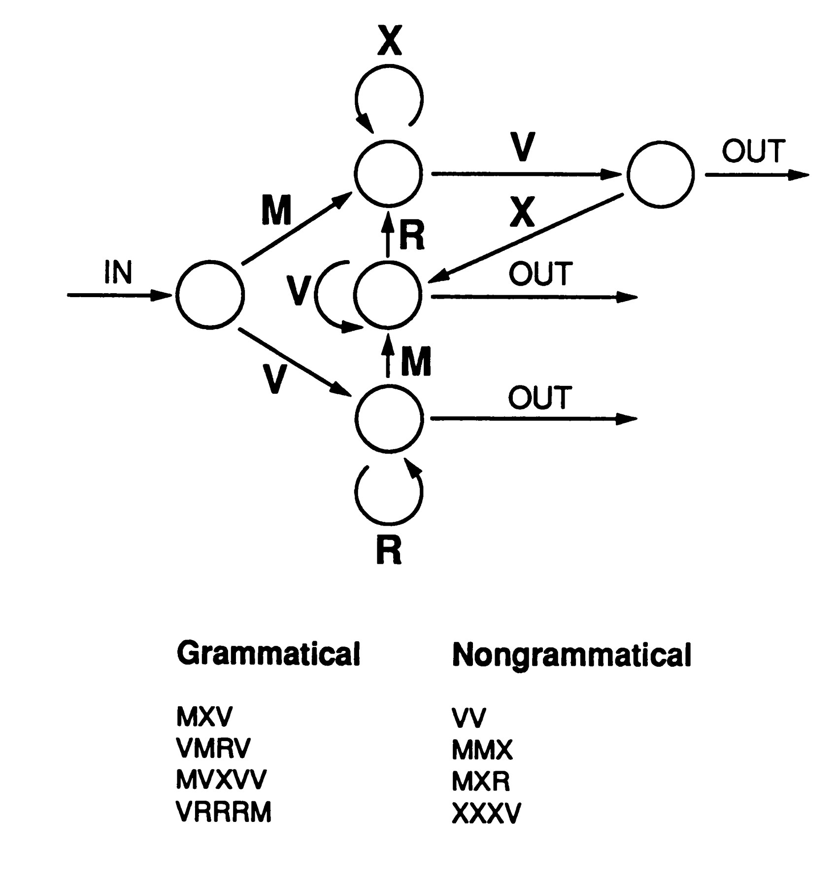
Implicit statistical learning
Past 20-30 years witnessed great interest in our ability to rapidly extract information from complex stimulus domains.
This ability is often referred to as implicit learning, statistical learning or even implicit-statistical learning (ISL).
Notes:
Fundamental process, underpins many complex behaviors: Language acquisition, music cognition, social interaction, intuitive decision making, etc.

Slide 16
Reminder: Implicit learning
What is implicit learning?
Ability to rapidly extract information from the environment
Learning that typically results in unconscious knowledge.
Examples
Language acquisition in childhood
Musical enculturation (Rohrmeier & Rebuschat, 2009)
Notes:
Social interaction, music cognition, intuitive decision-making, etc.

Slide 17
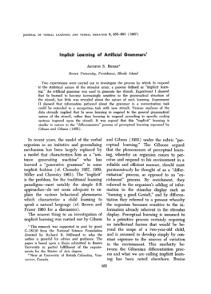
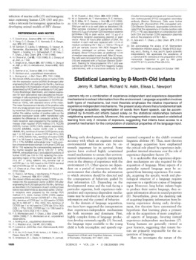
Two approaches, one phenomenon
Implicit learning
Reber (1967, 1969) onwards
Major strand in cognitive psychology
Statistical learning
Saffran, Aslin, and Newport (1996)
Major strand in developmental psychology
Notes:
Three related, yet completely distinct research communities:

Slide 18
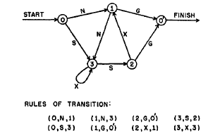
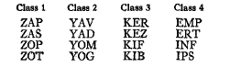
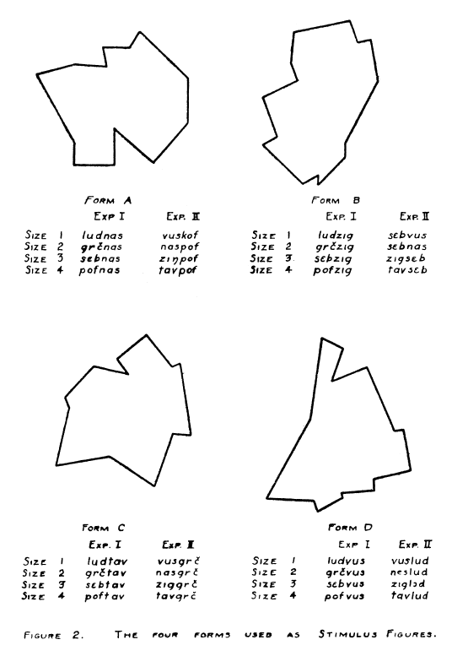
Commonalities
Shared origin
Miller (1958), Aborn & Rubenstein (1952), Horowitz & Jackson (1959), Braine (1963), Bogartz & Caterette (1963), Smith (1963), Segal & Halwes (1965), Foss (1968), etc.
Shared methodology
Use of artificial languages to investigate learning and memory
Shared belief
Artificial languages, including FSGs, can tell us something how we learn natural language
Notes:
Artificial languages as useful tool to investigate natural language acquisition Miller – “verbal learning”, Reber 1967, example that this is fundamental process, etc. Then ref from preface.
The proposed issue of Topics in Cognitive Science seeks to remedy this situation by bringing together leading researchers from a variety of disciplines (cognitive psychology, neuroscience, computer science, linguistics) who share an interest in the cognitive and neural bases of implicit-statistical learning. In addition to providing a snapshot of the exciting work being conducted in this area, the TopiCS issue would provide an important platform to (i) develop a shared understanding of research questions and methodologies, (ii) discuss similarities and differences between the two approaches, and (iii) formulate joint research agendas.
That first study was done using my favorite heuristic: Do simple experiments that make points with large implications. I hoped I was creating a mini-environment that could function as a platform to examine natural language learning. It was consciously crafted as a counterbalance to the Chomskyan Nativism which I felt, even then, was deeply flawed.

Slide 19
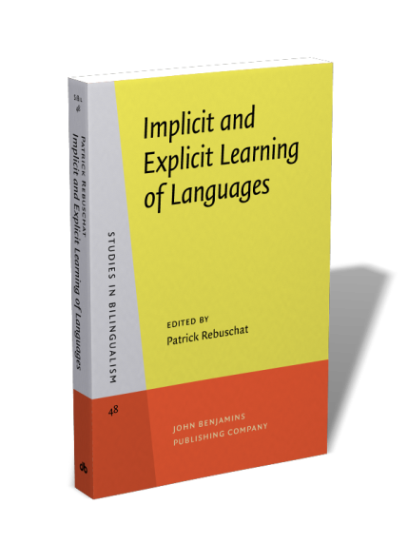
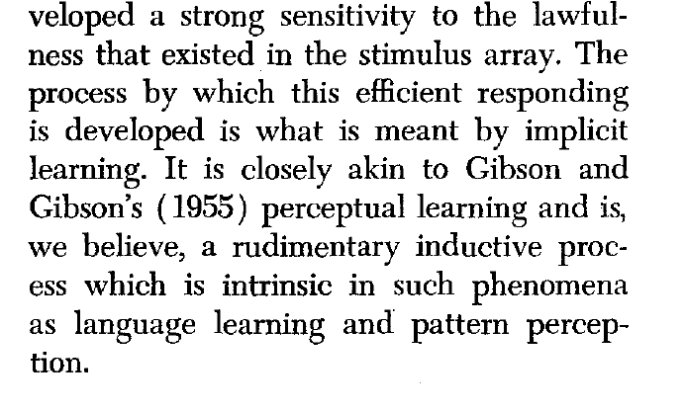
Using artificial grammars to understand language acquisition
“I hoped I was creating a mini-environment that could function as a platform to examine natural language learning. It was consciously crafted as a counterbalance to the Chomskyan Nativism which I felt, even then, was deeply flawed.” -- Reber (2015)
Notes:
Artificial languages as useful tool to investigate natural language acquisition Miller – “verbal learning”, Reber 1967, example that this is fundamental process, etc. Then ref from preface.
The proposed issue of Topics in Cognitive Science seeks to remedy this situation by bringing together leading researchers from a variety of disciplines (cognitive psychology, neuroscience, computer science, linguistics) who share an interest in the cognitive and neural bases of implicit-statistical learning. In addition to providing a snapshot of the exciting work being conducted in this area, the TopiCS issue would provide an important platform to (i) develop a shared understanding of research questions and methodologies, (ii) discuss similarities and differences between the two approaches, and (iii) formulate joint research agendas.
That first study was done using my favorite heuristic: Do simple experiments that make points with large implications. I hoped I was creating a mini-environment that could function as a platform to examine natural language learning. It was consciously crafted as a counterbalance to the Chomskyan Nativism which I felt, even then, was deeply flawed.

Slide 20
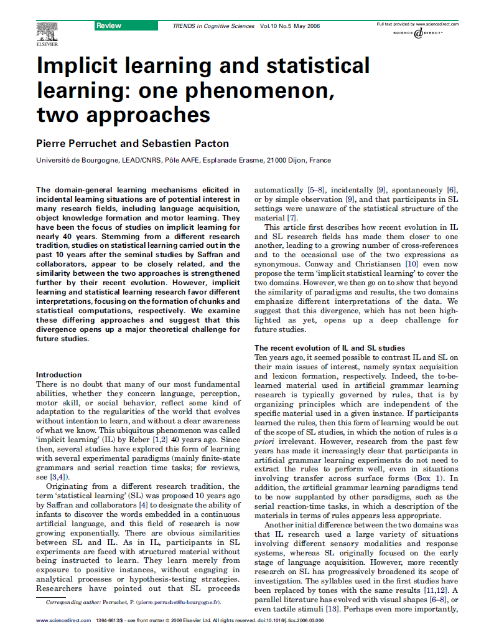
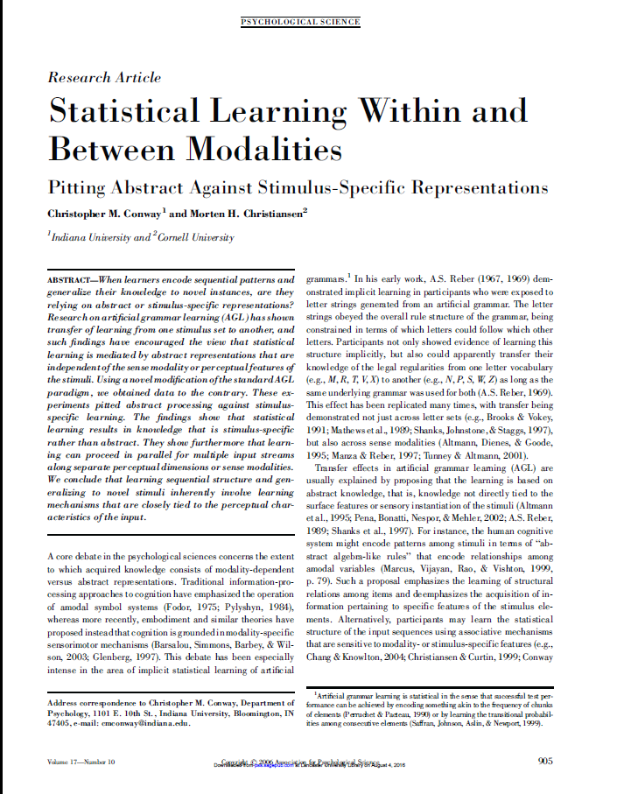
Commonalities
Notes:
Artificial languages as useful tool to investigate natural language acquisition Miller – “verbal learning”, Reber 1967, example that this is fundamental process, etc. Then ref from preface.
The proposed issue of Topics in Cognitive Science seeks to remedy this situation by bringing together leading researchers from a variety of disciplines (cognitive psychology, neuroscience, computer science, linguistics) who share an interest in the cognitive and neural bases of implicit-statistical learning. In addition to providing a snapshot of the exciting work being conducted in this area, the TopiCS issue would provide an important platform to (i) develop a shared understanding of research questions and methodologies, (ii) discuss similarities and differences between the two approaches, and (iii) formulate joint research agendas.

Slide 21
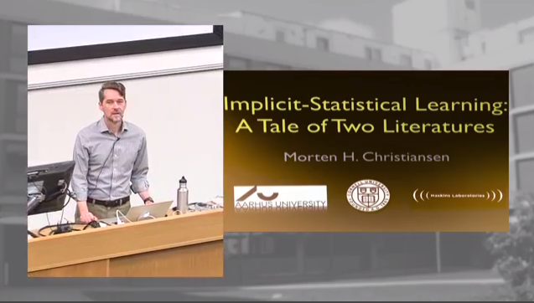
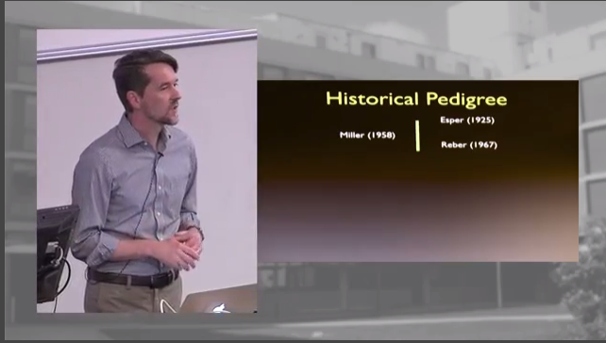
Commonalities
Great introduction to the “Tale of Two literatures” → Morten Christiansen keynote at Fifth Implicit Learning Seminar
www.lancaster.ac.uk/implicit-learning-seminar
https://youtu.be/LH85UFsxjqA
Notes:
Artificial languages as useful tool to investigate natural language acquisition Miller – “verbal learning”, Reber 1967, example that this is fundamental process, etc. Then ref from preface.
The proposed issue of Topics in Cognitive Science seeks to remedy this situation by bringing together leading researchers from a variety of disciplines (cognitive psychology, neuroscience, computer science, linguistics) who share an interest in the cognitive and neural bases of implicit-statistical learning. In addition to providing a snapshot of the exciting work being conducted in this area, the TopiCS issue would provide an important platform to (i) develop a shared understanding of research questions and methodologies, (ii) discuss similarities and differences between the two approaches, and (iii) formulate joint research agendas.

Slide 22
Three approaches, one phenomenon
Implicit learning
Reber (1967, 1969) onwards
Major strand in cognitive psychology
Statistical learning
Saffran, Aslin, and Newport (1996)
Major strand in developmental psychology
Second language acquisition
Krashen (1979), Bialystok (1978) onwards
Distinct research community
Notes:
I argue that there are actually at least three distinct research communities contribute sig to the topic of implicit learning.
Separate communities, separate journals, show initiatives to bring them together: my volumes, the conferences I organized: the 2016 CogSci event, the New Directions, ILS, see BCBL event.

Slide 23
Three approaches
 | IL | SL | SLA
Primary interest | Learning and memory | Language learning (though broader scope now, VSL) | Second language learning
Participants | Adults, other primates | Infants, children, adults, other primates | Adults, children
Stimuli | Artificial (FSG) | Artificial (PSG) | Artificial (PSG), semi-artificial, natural
Main paradigms | AGL, SRT | Word segmentation task, non-adj dependency learning, CSL | Language learning in lab and in the wild
Exposure length | 15-30 mins (AGL) 1-5 days (SRT) | 2-30 mins | 30-60 mins to 6 months
Awareness measures | Yes | No | Yes
Intervention | Rarely | No | Yes
Delayed posttest(s) | No | No | Yes

Slide 24
Exposure condition and awareness
Implicit learning and SLA
Careful manipulation of exposure condition
Incidental exposure as default
Statistical learning
Exposure is often intentional (“Learn which words go with which objects…”)
Systematic comparison of exposure conditions
Incidental vs intentional
Reber (1976), Reber et al. (1980), Berry & Broadbent (1988), Broadbent et al. (1986), Mathews et al. (1989), Jimenez (2001, Dienes et al (1991), Destrebcqz (2004), Van den Bos & Poletiek (2008) and many others
Exposure conditions not systematically compared
See Kachergis et al., 2010, 2014; Hamrick & Rebuschat, 2012; Arciuli et al., 2014; Stevens et al., in press, for recent exceptions
Why incidental exposure?
Notes:
Despite frequent acknowledgements that researchers in implicit learning and statistical learning might essentially be looking at the same phenomenon, there is surprisingly little alignment between the two strands.
The proposed issue of Topics in Cognitive Science seeks to remedy this situation by bringing together leading researchers from a variety of disciplines (cognitive psychology, neuroscience, computer science, linguistics) who share an interest in the cognitive and neural bases of implicit-statistical learning. In addition to providing a snapshot of the exciting work being conducted in this area, the TopiCS issue would provide an important platform to (i) develop a shared understanding of research questions and methodologies, (ii) discuss similarities and differences between the two approaches, and (iii) formulate joint research agendas.

Slide 25
Exposure condition and awareness
Implicit learning and SLA
Focus on whether the acquired knowledge is conscious or not
Verbal reports (retrospective)
Subjective measures of awareness
Objective measures of awareness
Statistical learning
Typically, no measures of awareness
See Hamrick & Rebuschat, 2011, 2012; Batterink et al., 2015; Franco et al., 2016; special issue of Frontiers
Why could it be important to check whether participants acquire implicit (unconscious) knowledge?
Notes:
Despite frequent acknowledgements that researchers in implicit learning and statistical learning might essentially be looking at the same phenomenon, there is surprisingly little alignment between the two strands.
The proposed issue of Topics in Cognitive Science seeks to remedy this situation by bringing together leading researchers from a variety of disciplines (cognitive psychology, neuroscience, computer science, linguistics) who share an interest in the cognitive and neural bases of implicit-statistical learning. In addition to providing a snapshot of the exciting work being conducted in this area, the TopiCS issue would provide an important platform to (i) develop a shared understanding of research questions and methodologies, (ii) discuss similarities and differences between the two approaches, and (iii) formulate joint research agendas.

Slide 26
Examples of research that bridges the three strands
Introduce a paradigm that brings together the different strands
Illustrate the advantages of combining insights and methods from the three strands → One approach, one phenomenon?
Series of experiments:
Paradigm > Cross-situational learning task (SL)
Manipulate exposure context (IL, SLA)
Add measures of awareness (IL, SLA)
From artificial to natural languages

Slide 27
Part II: A single paradigm to study implicit (language) learning

Slide 28
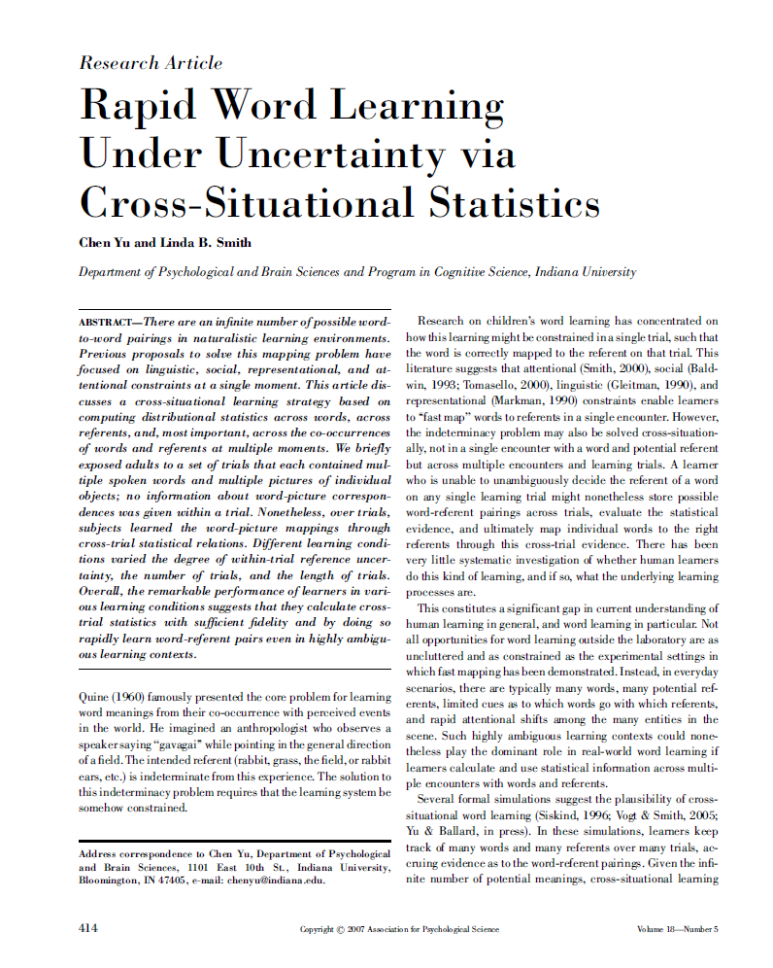
Cross-situational learning Yu and Smith (2007); Smith and Yu (2008)
Our ability to keep track of, and compare, information across many learning trials (situations) and to make use of this information to learn (language).
Notes:
Outside the lab, learning contexts are highly ambiguous. → Learners observe many potential referents and hear multiple words over many different trials.
Infants, children and adults cannot just track TPs. They can also use cross-trial evidence to learn language.
Confirmed by many expt studies since late 1970s.
Cross-situational learning
Children can learn new words via “fast mapping”, i.e. incidentally and with a single exposure trial.
Attentional, social, linguistic constraints permit us to rapidly link a novel sound to a referent in the environment.

Slide 29
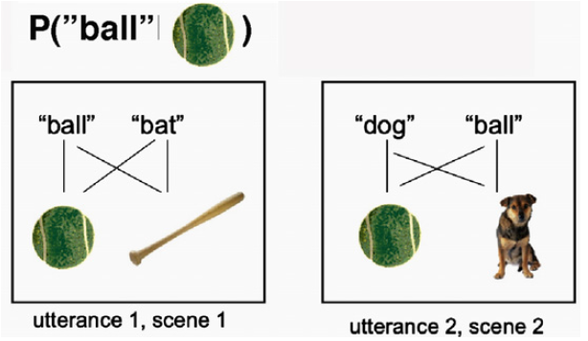
Cross-situational learning Yu and Smith (2007); Smith and Yu (2008)
2x2 condition: two referents, two words
Notes:
Infants, children and adults cannot just track TPs. They can also use cross-trial evidence to learn language.
Confirmed by many expt studies since late 1970s.

Slide 30
Cross-situational learning
Yu and Smith demonstrate that infants (12 to 14 months) and adults can use cross-situational learning to acquire novel nouns.
Scott and Fisher (2012) further showed that 2.5-year-old children can use CSL to acquire novel verbs.
Monaghan et al. (2015) confirms that adults can learn both nouns and verbs simultaneously from cross-situational statistics.

Slide 31
Monaghan, Schoetensack, & Rebuschat (2019)

Slide 32
Methods: Materials
Cross-situational learning task
Eight geometric shapes
Shapes are seen performing one of eight possible motions: bouncing, shaking, spinning, etc.
Eighteen pseudowords:
16 content words: Eight nouns, eight verbs
2 “function” words: One precedes shape words (nouns), the other motion words (verbs)

Slide 33
Methods: Materials
Cross-situational learning task
Participants observe two scenes.
Different shapes undergoing different motions.
After three seconds, sentence played over the headphones
E.g. “Tha makkot noo pakrid.”
Participants indicate which of the two scenes the sentence refers to.
No feedback is provided on accuracy of response.

Slide 34
Methods: Participants
Thirty NS of English, randomly assigned to two exposure conditions: Incidental vs intentional (each n = 15)
Participants were told they would see two scenes and hear a sentence. Their task was to choose which scene the sentence refers to (left or right).
Difference: Only instructed subjects are told about the function words (tha, noo) and that these always precede shape words (nouns) and motion words (verbs).

Slide 35
Methods: Procedure
Cross-situational learning task
Twelve training blocks
24 trials each = 288 exposure trials.
Testing blocks (13 and 14): Noun and verb tests
Debriefing questionnaire after the final block
Verbal reports as measure of awareness
Lack of verbalization as criterion of implicitness (Reber, 1967)
Notes:
Frequency of motions, shapes balanced across blocks.
Within each blocks, each motion occurred six times and each word three times.

Slide 36
Results: CSL task
Overall accuracy across 12 training blocks:
Incidental group: 72%
Intentional group: 83%
Noun test:
Incidental group: 83%
Intentional group: 96%
Verb test:
Incidental group: 85%
Intentional group: 96%
*
Clear learning effect in both groups, with intentional group sig outperforming incidental group in each case.
*
*
Notes:
Designed to identify strategies participants followed during and to determine whether they became aware of any patterns.

Slide 37
Results: CSL task
Incidental group: Sig above chance from block 7
Intentional group: Sig above chance from block 4
Significant difference btw groups from block 5.
Simply telling subjects about function words sig affects learning rate and ultimate attainment.
Notes:
Designed to identify strategies participants followed during and to determine whether they became aware of any patterns

Slide 38
Results: Verbal reports
Were participants aware of the function words and the role they played?
Intentional group:
Yes, of course. (We had told them.)
Incidental group:
Seven remained unaware of the role of the function words.
Seven subjects aware of both function words and of the types of words with which they were associated.
This explicit (conscious) knowledge was acquired as a result of exposure.
Notes:
Designed to identify strategies participants followed during and to determine whether they became aware of any patterns.

Slide 39
Results: Aware vs unaware subjects
These are subjects from the incidental group.
Overall accuracy across 12 training blocks:
Unaware subjects: 66%
Aware subjects: 80%
Noun test:
Unaware subjects: 79%
Aware subjects: 89%
Verb test:
Unaware subjects: 84%
Aware subjects: 87%
Clear learning effect in both subgroups, but no significant differences between groups.
But…
Notes:
Difference approaching significance, p = .075

Slide 40
Results: Aware vs unaware subjects
Unaware subgroup: Sig above chance from block 8
Aware subgroup: Sig above chance from block 5
Significant difference btw subgroups btw blocks 3 and 7.
Exposure > testing paradigms cannot capture the difference!
Proportion correct
Notes:
Proportion of correct responses in each training block for aware and unaware participants of the incidental group.

Slide 41
Results: Aware vs unaware subjects
Unaware subgroup: Sig above chance from block 8
Aware subgroup: Sig above chance from block 5
Significant difference btw subgroups btw blocks 3 and 7.
Subjects with explicit knowledge perform better.
Proportion correct
Notes:
Proportion of correct responses in each training block for aware and unaware participants of the incidental group.

Slide 42
Summary
Adult subjects can rapidly learn novel nouns and verbs without intending to, without feedback, and without becoming aware of the knowledge they have acquired.
Does explicit knowledge make a difference? Yes!
Simply telling subjects about the existence of function words significantly boosts (statistical) learning.
Incidental subjects who figured out the underlying “rule” outperform subjects who did not.
Notes:
Declarative memory (and to some extent PSTM) = key predictor variable

Slide 43
Summary
Implicit-explicit interface
Impact of explicit knowledge on the implicit-statistical learning mechanism (cf intentional group)
How does explicit knowledge emerge as a result of implicit-statistical learning? (cf incidental-aware subgroup)
Methodological implications: Highlights benefits of comparing of exposure conditions and of adding of awareness measures
Notes:
Declarative memory (and to some extent PSTM) = key predictor variable

Slide 44
Part III: Conclusion and looking ahead

Slide 45
What do these expts show?
Adults can rapidly learn novel nouns, verbs, adjectives, marker words and basic syntactic patterns via cross-situational learning.
The results have been replicated in follow-up experiments.
The results have been observed with natural languages (Japanese and Latin), from artificial to natural languages (e.g., Rebuschat et al, 2021, Cognition; Walker et al, 2017, under review, Wendebourg et al, under review).
Knowledge is robust after 24 hours – and scores might improve, so a delayed post-test is advisable to ensure we are not underestimating how much is learned.
This is not due to the dual-screen task; it works with single-screen, too (Rebuschat et al, under review).

Slide 46
What do these expts show?
Explicit knowledge boosts learning rate and ultimate attainment.
But the candidate for intervention needs to be carefully selected. There is no need to focus on aspects of language that are readily acquired without explicit intervention.
Contrasting exposure conditions and measuring awareness can deepen our understanding of the mechanism(s) underlying language learning.
Exposure condition matters. The relationship between exposure condition and type of acquired knowledge (implicit vs explicit) is complex.

Slide 47
What do these expts show?
Engaging with different research communities can lead to novel paradigms that allow us to explore topics from a new angle.
Implicit learning
Reber (1967, 1969) onwards
Statistical learning
Saffran, Aslin, and Newport (1996)
Second language acquisition
Krashen (1979), Bialystok (1978) onwards

Slide 48
Questions?

Slide 49
Experiment 2 – if time
Rebuschat, Schoetensack, & Monaghan (2021, Cognition)

Slide 50
Experiment 2
Experiment 1 (as well as Monaghan et al., 2015) showed that adults can learn different types of content words (here, nouns and verbs) simultaneously from cross-situational statistics.
But what about other lexical items like function words? And what about syntax?
Can we learn words (nouns, verbs, adjectives, function words) and syntax simultaneously via cross-situational learning?
Notes:
This is an important observation because in natural language learning we learn many things simultaneously.

Slide 51
Methods: Participants
Twenty NS of English
No background in Japanese or any other VF language
Mean age: 20.3 years (range 20-28)

Slide 52







Methods: Novel artificial language
Eight alien cartoon characters, can occur in red or blue
Notes:
Novel artificial language was created for this experiment. There were eight alien cartoon characters, which could either appear in red or blue (see Appendix 1). Aliens were depicted performing one of four actions (hiding, jumping, lifting, pushing) in dynamic scenes generated by E-Prime (version). Figure 1 shows a sample scene.

Slide 53
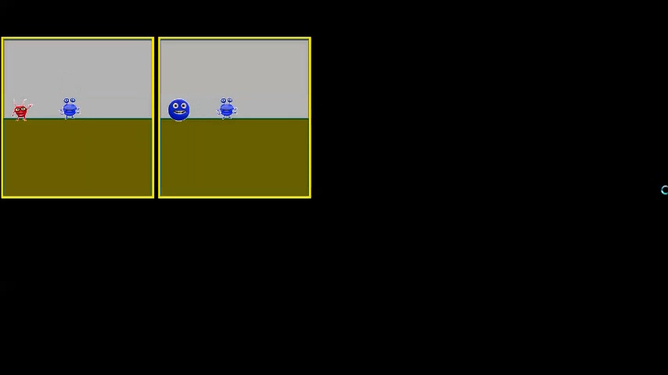
Methods: New artificial language
Aliens are depicted performing one of four actions (hiding, jumping, lifting, pushing) in dynamic scenes generated by E-Prime.
Notes:
Novel artificial language was created for this experiment. There were eight alien cartoon characters, which could either appear in red or blue (see Appendix 1). Aliens were depicted performing one of four actions (hiding, jumping, lifting, pushing) in dynamic scenes generated by E-Prime (version). Figure 1 shows a sample scene.

Slide 54
Methods: New artificial language
Lexicon = 16 pseudowords
Fourteen bisyllabic pseudowords:
Eight nouns (one per alien)
four verbs (one per action)
two adjectives (one per color)
Two monosyllabic pseudowords:
Indicated if the preceding noun referred to the subject or the object of the sentence.
Content words
Function words
Random word-referent mappings for each participant.
Notes:
were randomly generated for each participant to control for preferences in associating certain sounds to objects, motions or colors.

Slide 55
Methods: New artificial language
Artificial language syntax = based on Japanese:
Sentences either SOV or OSV
Generated 192 training sentences and 96 test sentences
Lexical frequencies, agent-patient assignment, and word order carefully counterbalanced.
Notes:
In terms of syntax, the artificial language was based on Japanese. Sentences could either be SOV or OSV, i.e. verb phrases (VP) had to be placed in final position but the order of subject and object noun phrases (NP) was free. VPs only contained the verb (V) as its head. NPs had to contain a noun (N) as its head and a post-nominal case marker that indicated if the preceding known was the agent (Case_{subj}) or the patient (Case_{obj}) of the action. Adjectives (Adj) were optional and only occurred in half the NPs. When adjectives were present, these had to occur pre-nominally. There were 192 training sentences and 96 test sentences, with lexical frequencies, agent-patient assignment, and word order carefully counterbalanced. Table 1 summarizes the grammatical sentence patterns that occurred, with equal frequency, in the experiment.
controlling for:
each alien occurs with each other alien only once in each block
each alien occurs twice as subject, twice as object in each block
each alien occurs no more than twice with each verb
each verb occurs twice as SOV and twice as OSV
each verb occurs no more than twice as none/both/Subject/Object
adjectives occur equal number of times with OSV and SOV
noticed that OSV/SOV not balance din terms of co-occurring with adjectives. This is important, because it's a syntactic co-occurrence whereas the lexical co-occurrences vary across blocks. I've therefore changed the first block here, and also adjusted the conditions that we're meeting.
Other scene: no actions are the same, no aliens are the same
othercolor: equal nos of same-color, different-color

Slide 56
Methods: New artificial language
Hagal chilad tha garshal sumbad noo thisslin.
Word order | Syntactic pattern
 | Phrase 1 | Phrase 2 | Phrase 3
SOV | NP_{subj} (Adj N Case_{nom}) | NP_{obj} (Adj N Case_{acc}) | VP (V)
 | NP_{subj} (Adj N Case_{nom}) | NP_{obj} (N Case_{acc}) | VP (V)
 | NP_{subj} (N Case_{nom}) | NP_{obj} (Adj N Case_{acc}) | VP (V)
 | NP_{subj} (N Case_{nom}) | NP_{obj} (N Case_{acc}) | VP (V)
OSV | NP_{obj} (Adj N Case_{acc}) | NP_{subj} (Adj N Case_{nom}) | VP (V)
 | NP_{obj} (Adj N Case_{acc}) | NP_{subj} (N Case_{nom}) | VP (V)
 | NP_{obj} (N Case_{acc}) | NP_{subj} (Adj N Case_{nom}) | VP (V)
 | NP_{obj} (N Case_{acc}) | NP_{subj} (N Case_{nom}) | VP (V)
Each pattern occurs 24 times
Notes:
In terms of syntax, the artificial language was based on Japanese. Sentences could either be SOV or OSV, i.e. verb phrases (VP) had to be placed in final position but the order of subject and object noun phrases (NP) was free. VPs only contained the verb (V) as its head. NPs had to contain a noun (N) as its head and a post-nominal case marker that indicated if the preceding known was the agent (Case_{subj}) or the patient (Case_{obj}) of the action. Adjectives (Adj) were optional and only occurred in half the NPs. When adjectives were present, these had to occur pre-nominally. There were 192 training sentences and 96 test sentences, with lexical frequencies, agent-patient assignment, and word order carefully counterbalanced. Table 1 summarizes the grammatical sentence patterns that occurred, with equal frequency, in the experiment.
controlling for:
each alien occurs with each other alien only once in each block
each alien occurs twice as subject, twice as object in each block
each alien occurs no more than twice with each verb
each verb occurs twice as SOV and twice as OSV
each verb occurs no more than twice as none/both/Subject/Object
adjectives occur equal number of times with OSV and SOV
noticed that OSV/SOV not balance din terms of co-occurring with adjectives. This is important, because it's a syntactic co-occurrence whereas the lexical co-occurrences vary across blocks. I've therefore changed the first block here, and also adjusted the conditions that we're meeting.
Other scene: no actions are the same, no aliens are the same
othercolor: equal nos of same-color, different-color

Slide 57
Methods: Materials
Cross-situational learning task, with 16 blocks
Eight exposure blocks → exposure trials only
Four mixed blocks → exposure trials and lexical test trials
Four test blocks → syntactic test trials
 | Block
 | 1 | 2 | 3 | 4 | 5 | 6 | 7 | 8 | 9 | 10 | 11 | 12 | 13 | 14 | 15 | 16
Block type | Exp | Exp | M | ST | Exp | Exp | M | ST | Exp | Exp | M | ST | Exp | Exp | M | ST
Nr of trials | 16 | 16 | 16 24 | 16 | 16 | 16 | 16 24 | 16 | 16 | 16 | 16 24 | 16 | 16 | 16 | 16 24 | 16
Notes:
The exposure blocks contained 16 exposure trials each. The mixed blocks contained 16 exposure trials and eight interspersed test trials, which assessed lexical knowledge (two trials per lexical category). Finally, the test blocks contained 16 trials and assessed syntactic knowledge. Presentation order within each block was randomized but all participants completed blocks in the same sequence. Table 2 illustrates the training and testing sequence.

Slide 58
Methods: Procedure
Exposure trials and lexical test trials
Participants informed that they would learn a new language, spoken by “friendly inhabitants of a distant planet”.
They observed two dynamic scenes and hear a sentence in the alien language over headphones.
Task: Decide, as quickly and accurately as possible, which scene the sentence referred to.
No feedback!
 | Block
 | 1 | 2 | 3 | 4 | 5 | 6 | 7 | 8 | 9 | 10 | 11 | 12 | 13 | 14 | 15 | 16
Block type | Exp | Exp | M | ST | Exp | Exp | M | ST | Exp | Exp | M | ST | Exp | Exp | M | ST
Nr of trials | 16 | 16 | 40 | 16 | 16 | 16 | 40 | 16 | 16 | 16 | 40 | 16 | 16 | 16 | 40 | 16
Notes:
(“1” for left, “2” for right). The locations of the target scene were counterbalanced and randomized. No feedback was provided on response accuracy

Slide 59
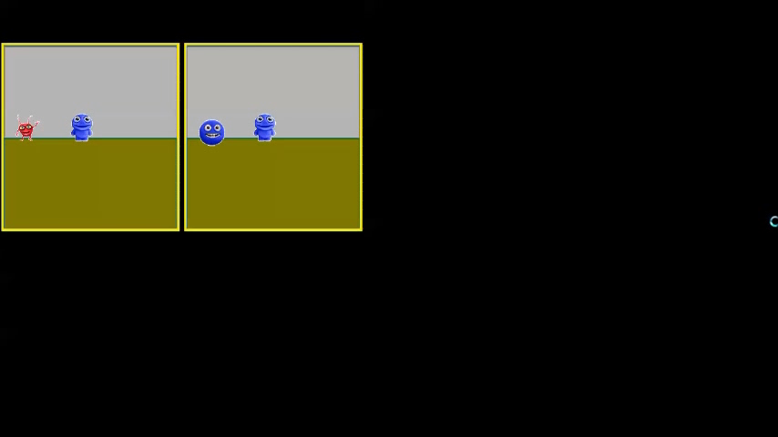
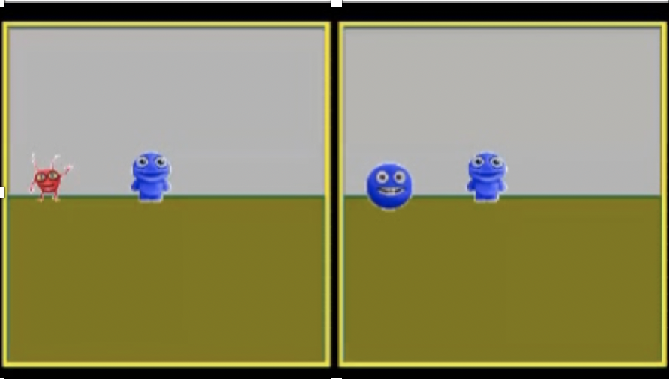
Methods: Participants
Hagal chilad tha garshal sumbad noo thisslin.

Slide 60
Methods: Procedure
Exposure trials and lexical test trials
In the lexical test trials (24 per block), the scenes were identical with one difference.
 | Aliens | Colors | Actions | Agent-patient assignment
Noun test | Different | Same | Same | Same
Verb test | Same | Same | Different | Same
Adjective test | Same | Different | Same | Same
Marker test | Same | Same | Same | Different
No feedback!
Notes:
(“1” for left, “2” for right). The locations of the target scene were counterbalanced and randomized. No feedback was provided on response accuracy

Slide 61

Methods: Procedure
Syntactic test trials
Subjects see one dynamic scene and hear a sentence spoken by another alien from a very different planet who was also learning the new language.
Task: Decide, as quickly and accurately as possible, whether the new alien was speaking correctly (in relation to the artificial language).
 | Block
 | 1 | 2 | 3 | 4 | 5 | 6 | 7 | 8 | 9 | 10 | 11 | 12 | 13 | 14 | 15 | 16
Block type | Exp | Exp | M | ST | Exp | Exp | M | ST | Exp | Exp | M | ST | Exp | Exp | M | ST
Nr of trials | 16 | 16 | 40 | 16 | 16 | 16 | 40 | 16 | 16 | 16 | 40 | 16 | 16 | 16 | 40 | 16
Notes:
Patterns: SOV, OSV vs *SVO, *OVS, *VSO, *VOS

Slide 62
Methods: Procedure
After completing the cross-situational learning task, participants completed a debriefing questionnaire.
Assessing strategy use and awareness of acquired knowledge.
Notes:
Designed to identify strategies participants followed during and to determine whether they became aware of any patterns.

Slide 63
Results
Overall accuracy in….
exposure trials: 72% *
lexical test trials: 61% *
syntactic test trials: 78% *
Clear learning effect
Notes:
Designed to identify strategies participants followed during and to determine whether they became aware of any patterns.

Slide 64
Results: Exposure trials
Performance sig above chance from block 3.
48 exposure trials enough to lead to above-chance performance.
Notes:
Designed to identify strategies participants followed during and to determine whether they became aware of any patterns

Slide 65
Results: Lexical and syntactic tests
Acquisition sequence:
Verbs and syntax
Nouns
Adjectives
Marker words
Notes:
Designed to identify strategies participants followed during and to determine whether they became aware of any patterns.
Participants report that they were guessing initially and that they used prior knowledge to make decisions in future trials via a process of elimination.

Slide 66
Discussion
Adult subjects can learn novel nouns, verbs and syntax simultaneously, without intending to, without feedback, and without becoming fully aware of the knowledge they have acquired.
Participants might also learn adjectives and marker words, though learning appears limited.
Notes:
Why verbs? Verbs were in final position. Consolidation of vocabulary but not grammar (Mirkovic & Gaskell 2016)?

Slide 67
Variations

Slide 68
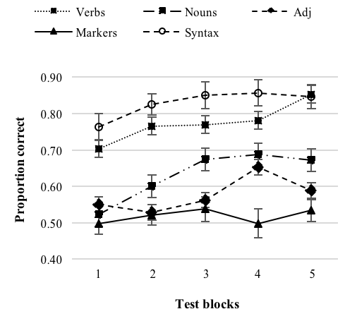
Walker et al (under review) Neil Walker (PhD student, Lancaster)
Performance on massed condition replicates previous expt
Confirms learning sequence: Syntax and verbs > nouns > adj > markers
Delayed PT confirm acquired knowledge robust after 24 hrs
Notes:
Learning sequence:
Syntax (word order) and verbs (all tests above chance)
Nouns (tests 2-5 above chance)
Adjectives (tests 4-5 above chance)
Markers (test 5 above chance)

Slide 69






Why not use a natural language?
シマウマが鶏を飛び越える
Notes:
Shimauma ga niwatori o tobikoeru

Slide 70
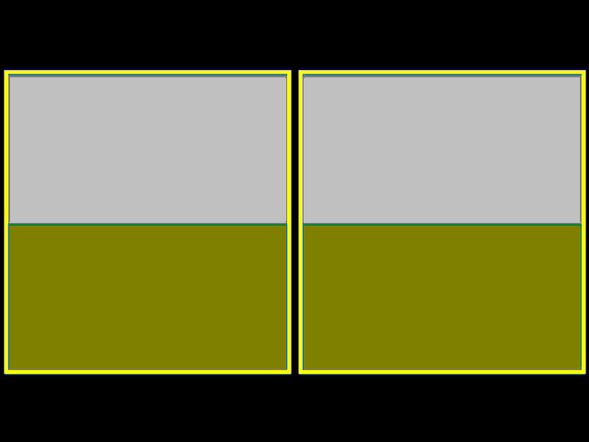

Natural language version: Japanese

Slide 71
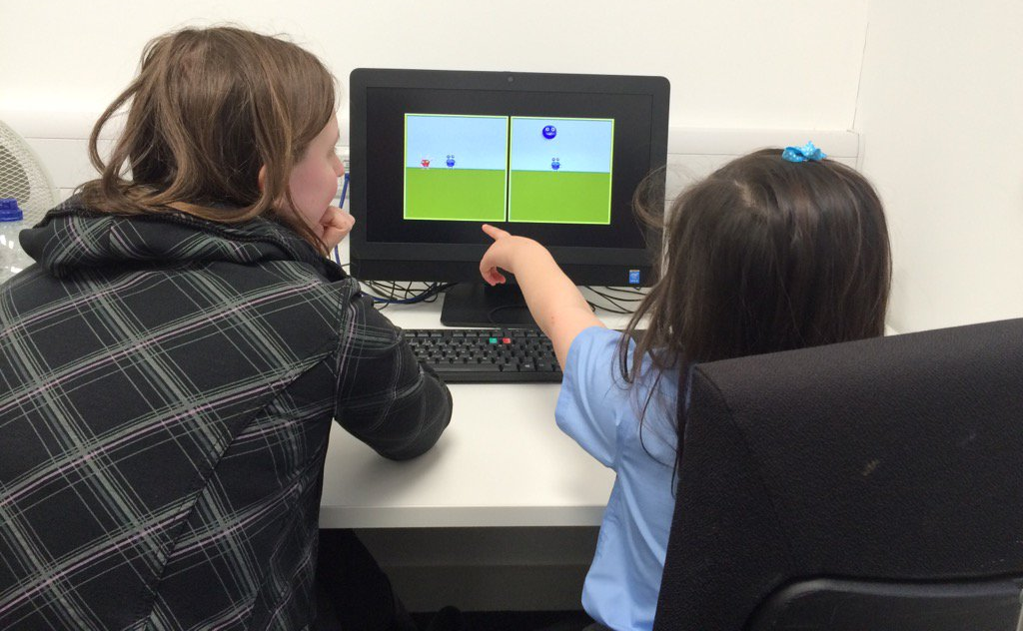
Testing children
After piloting with children (5-10 years), we have
made tasks more child friendly (e.g. grammaticality judgments)
simplified the artificial language (reduced lexicon, same syntax).
Notes:
Mention we have been piloting a lot to make sure the tasks AND the artificial language become more child-friendly.
The artificial language has still same syntax but reduced lexicon: four nouns, four verbs, two function words.

Slide 72
Testing children
Two completed studies:
Bilingualism study: Tested 40+ Hungarian-English children (8-9 years) → Dunn, Rebuschat, & Monaghan (in prep)
English monolinguals: 8-9, 11-12, 17-18-year olds. → Rebuschat, Farrimond, & Monaghan (in prep)
Notes:
Adult study: Syntax and verbs > nouns > adj, markers
11-12 year olds: Verbs > nouns, markers. No syntax!
8-9 year olds: Nouns only
17-18 year olds: No learning (in the right direction)

Slide 73



Wendebourg et al. (under review) Katharina Wendebourg (Tuebingen LEAD/Lancaster)
Acquisition of Latin word order, nouns, verbs, morphology (singular vs plural, subject vs object markers)
Function words and morphological markers are not acquired easily. → Good target for pedagogical intervention via explicit instruction
Three groups: Incidental, explicit-partly, explicit-fully
Notes:
Saganae stolidum inrident. OR Stolidum saganae inrident.

Slide 74


Wendebourg et al. (under review)
Learning effects in all conditions but strongest in fully explicit.
Sequence: Syntax and verbs > nouns > morph (sing/pl) > morph (subj/obj)
Notes:
Mention we have been piloting a lot to make sure the tasks AND the artificial language become more child-friendly.
The artificial language has still same syntax but reduced lexicon: four nouns, four verbs, two function words.

